Slide 1
TUPLES
Notes:
Welcome to the module on Tuples Data structure in Python.

Slide 2

In this Module You will learn
Identify tuple and set data structure
Distinguish between list and a tuple
Employ inbuilt methods to manipulate tuple data
Implement Set data structure
Notes:
In this section, you will be able to identify and work with the tuple data structure in Python,
Distinguish between a list and a tuple, and employ in-built methods to perform various operations to manipulate data.
Also, you will be able to understand and implement a set data structure.

Slide 3
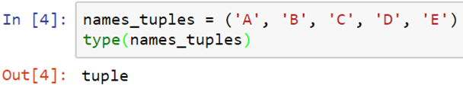
Tuples
Let us understand the concept of LISTS
TUPLE
TUPLE
Similar to list, but tuples are immutable (the elements cannot be modified).
The syntax uses parenthesis instead of square brackets
Tuples can also be created without parenthesis. useful when returning multiple results in a function.
Notes:
A tuple is a sequence of immutable Python objects. Tuples are sequences, just like lists.
The differences between tuples and lists are, the tuples cannot be changed unlike lists and tuples use parentheses, whereas lists use square brackets.

Slide 4
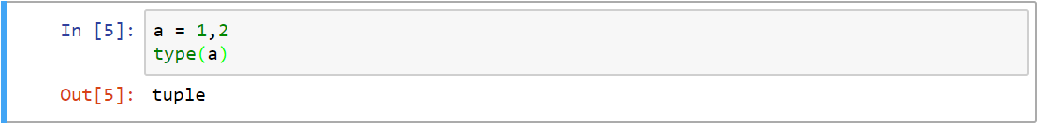
Tuples
Tuples can also be created without parenthesis.
Tuples are very useful when returning multiple results in a function
Notes:
We can also create tuple without using parenthesis and it is useful when we want to return multiple results from a function.

Slide 5
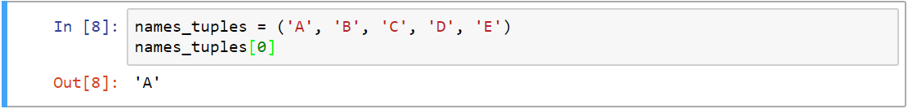
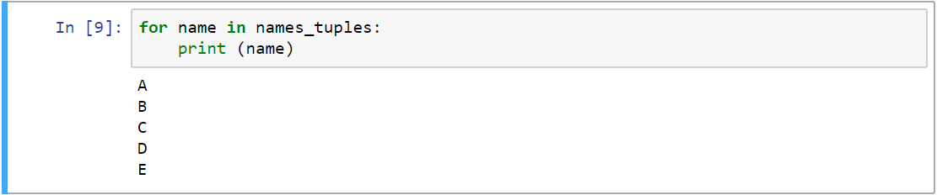
Accessing Elements In Tuples
Elements in a tuples can be accessed similar to list. We can use the element’s index to access them
We can also use for loop to access each element in a tuple, just like a list
Notes:
Just Like list, when we want to access an element from a tuple, we can use its index or we can use for loop to access each element in a tuple.
Observe the given code snippets for sample.

Slide 6
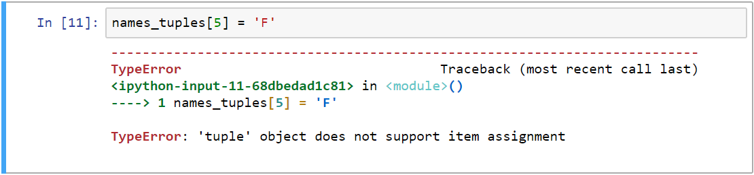

Tuples - Immutable
In tuples elements cannot be appended or edited, unlike list
In the first example we are trying to append an element and the second example, we are trying to modify the first element in the tuple
Notes:
Like list, we cannot edit or append elements into a tuple. In the first code snippet, we are trying to append at the end of the tuple and in the second code snippet, we are trying to modify the first element. You can see that, both the code lead to an error.

Slide 7
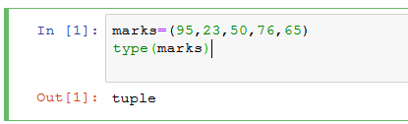
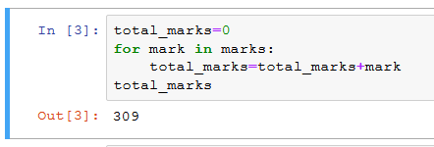
Sample code 1
Using the following tuple, calculate the total marks
Solution:
Problem:
Notes:
Observe the sample program which helps us to calculate the total marks using tuple.
Define a tuple called marks which contains 5 marks. Later, using for loop , iterate through each marks and in each iteration, the mark is Getting added to the object variable ‘total_marks’. Finally print the total_marks variable.

Slide 8
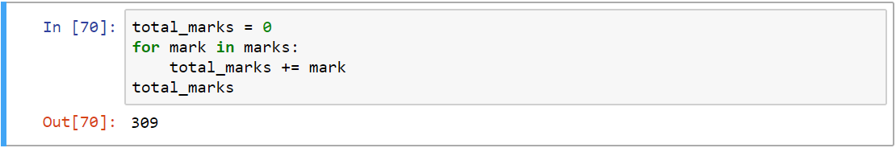
Sample code 1– Alternate Solution
Use “+=“ to add right operand to the left, as shown below:
Use inbuilt sum() function to calculate the total marks
Notes:
There are some alternate solutions to find out the sum of elements in a tuples. In the first sample code depicts the usage of short hand operators “+=“ to add the right operand to the left .
The second sample code depicts the usage of the in-built method sum() to add the elements in a tuple.
Almost all the in-built methods that used with lists can be applied to tuples too.

Slide 9
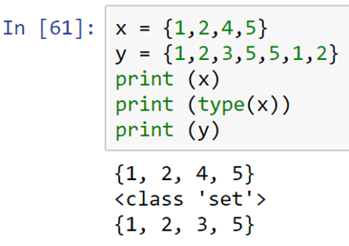

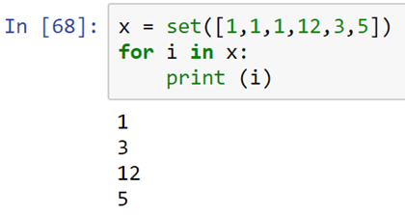
Set – Data Structure
A set is an unordered collection of items
Every element is unique (no duplicates) and it is immutable (which cannot be changed)
However, the set itself is mutable. We can add or remove items from it
A set is an unordered collection of items
Every element is unique (no duplicates) and it is immutable (which cannot be changed)
However, the set itself is mutable. We can add or remove items from it
One can use for loop to access the individual elements, but the order will not be maintained
Even if the values that are passed for set function contain
duplicates, the method will remove them and will store only unique values
!
Notes:
A set is an unordered collection of items.
Every element is unique in the set and the elements are immutable, that is - they cannot be changed once created.
However, the set itself is mutable.
We can add or remove items from it.
To create a set, we have to pass a collection of elements within flower braces.
The elements should be comma-separated.
Let's take an example, in the first line we are creating a set called x, with values 1,2,4,5.
The set does not contain any duplicates while getting created.
Let's create another set that has duplicates on creation.
For example, here the values like 5, 1, 2 are duplicated.
But when we print the values in y, we see only the unique elements in the collections.
Even though the values that are passed for the set function contains duplicates, the method will remove them and will store only unique values.
The set function is used very often to remove duplicates from the list.
In this example, we are passing a list to the set function.
The output is a set with only the unique elements in the list.
Since sets are unordered, the elements cannot be accessed using their position - that is its index.
Python will throw an error if we index a set.
Instead, one can use a for loop to access the individual elements, but the order will not be maintained.
For example in this list, the value 3 appears after 12 while creating the set.
But while looping through each element and printing the same, we can see that the value 3 appears before 12.
This is a simple for loop which is used to access one element at a time.

Slide 10

In this Module You have learnt to
Identify tuple data structure
Distinguish between list and a tuple
Employ inbuilt methods to manipulate tuple data
Implement set data structure
Notes:
Having completed this session you would have learnt to ,
Identify tuple data structure
Distinguish between list and a tuple
Employ inbuilt methods to manipulate tuple data
Implement set data structure

Slide 11
THANK you
Notes:
THANK you FOR the attention.

